Slide 1
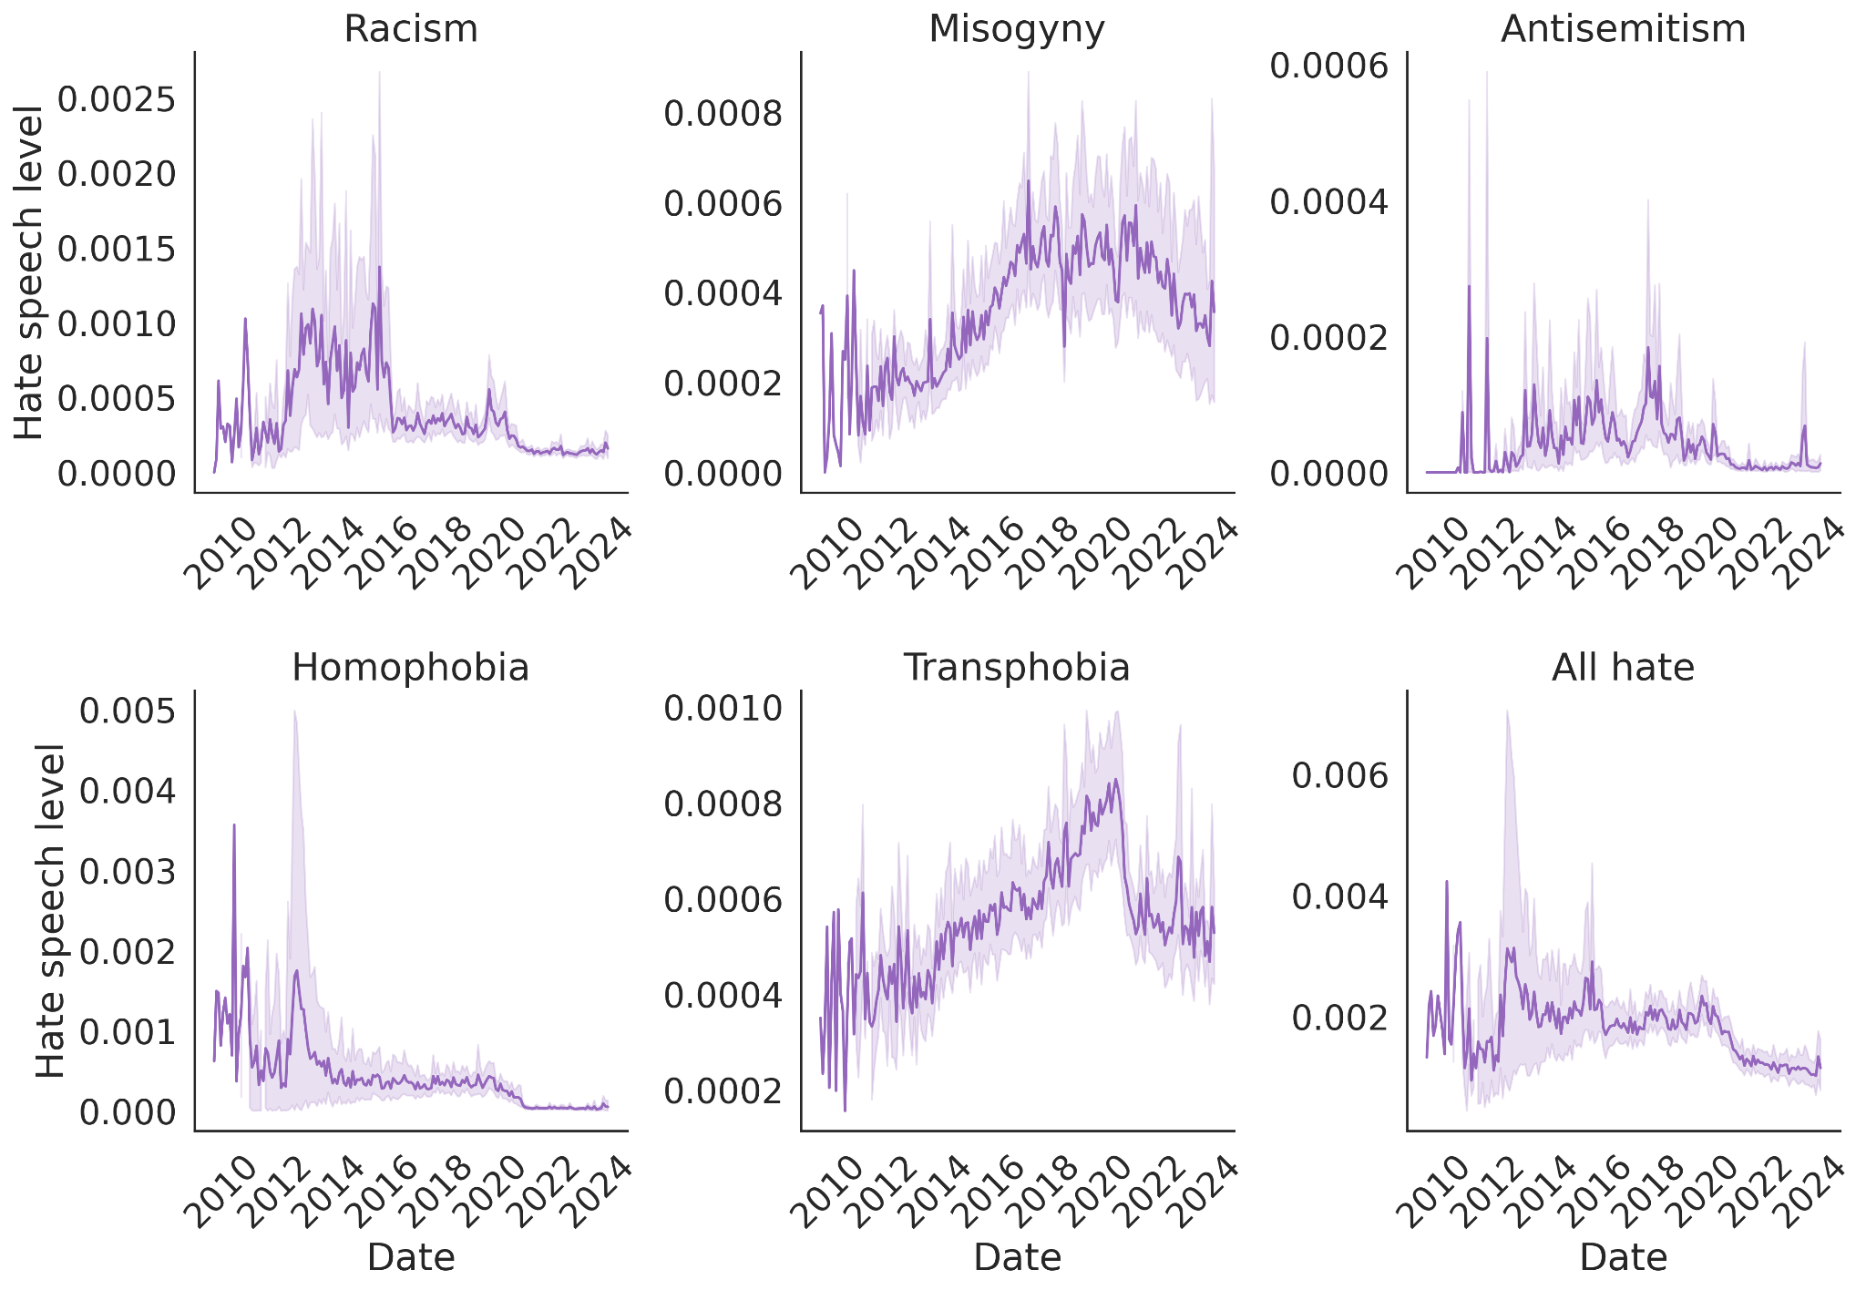




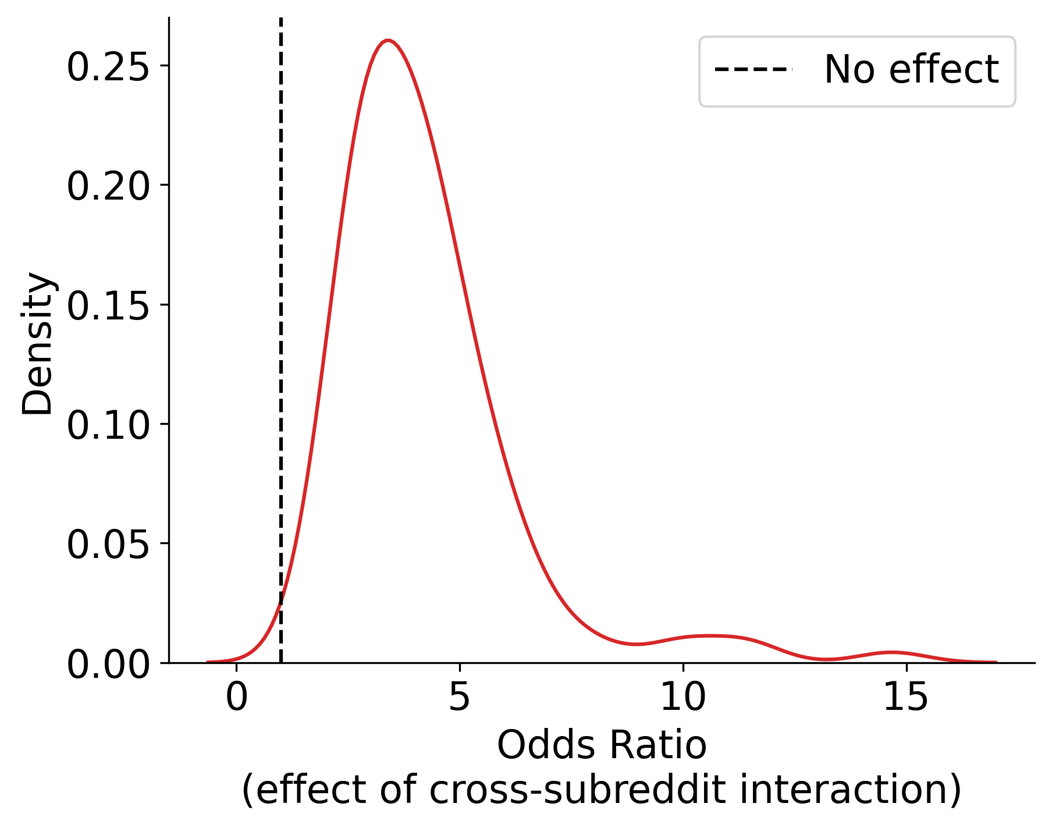
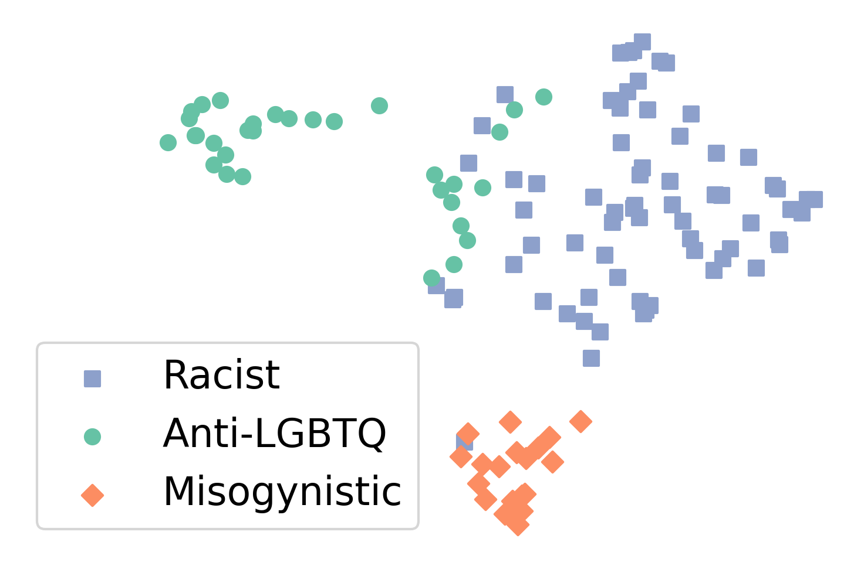
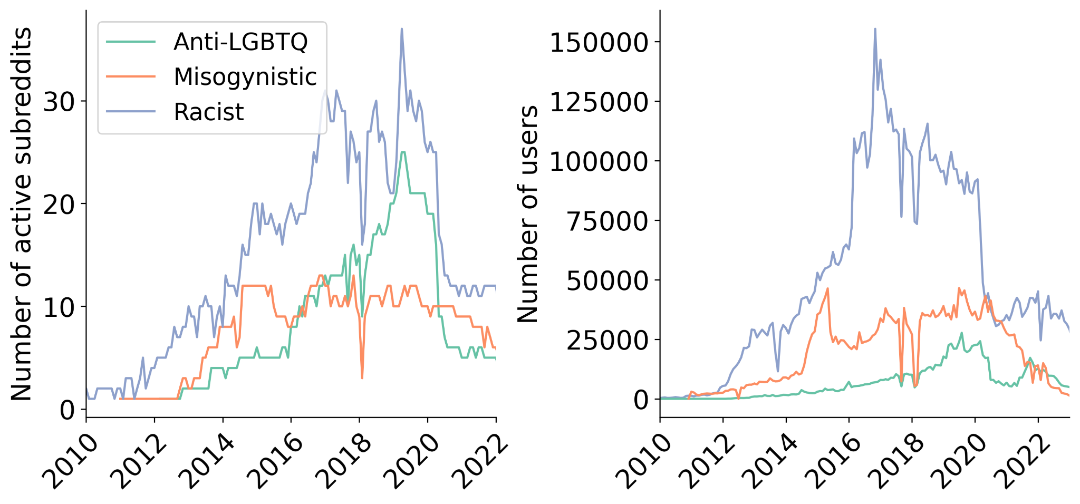
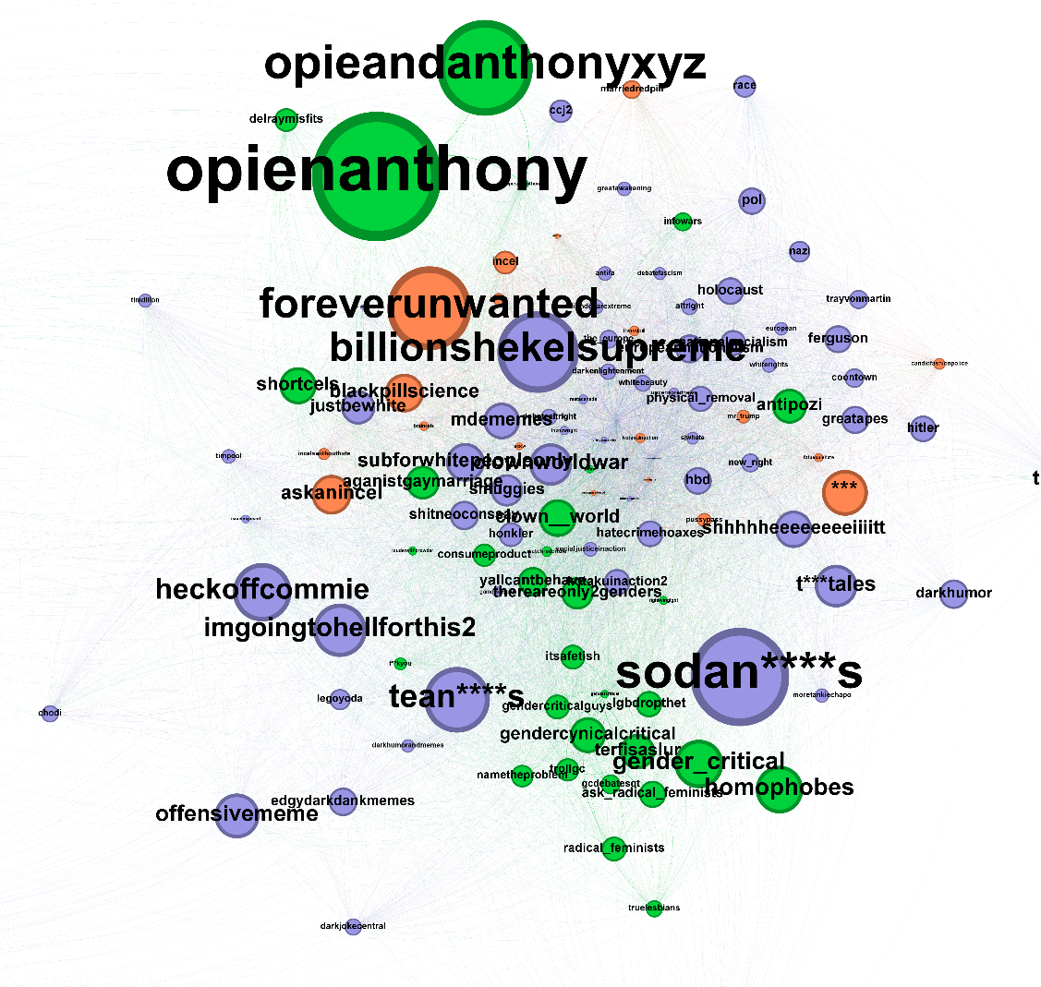
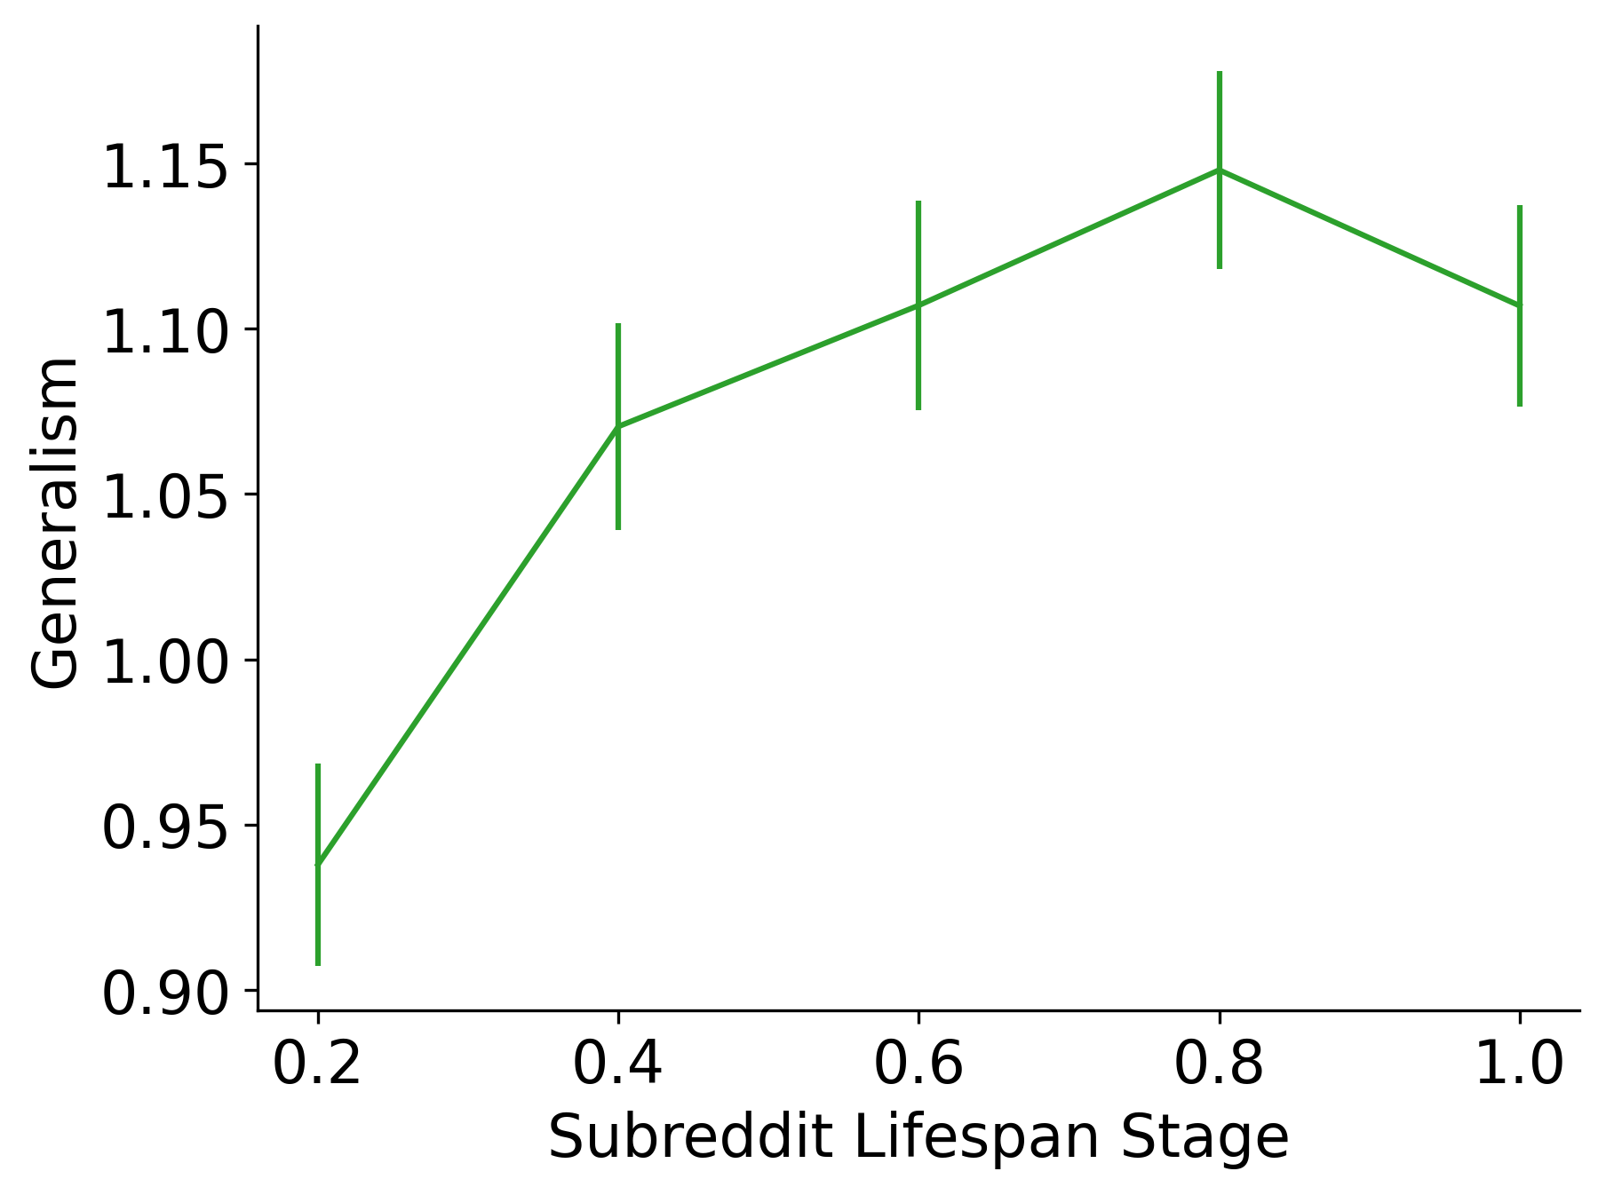
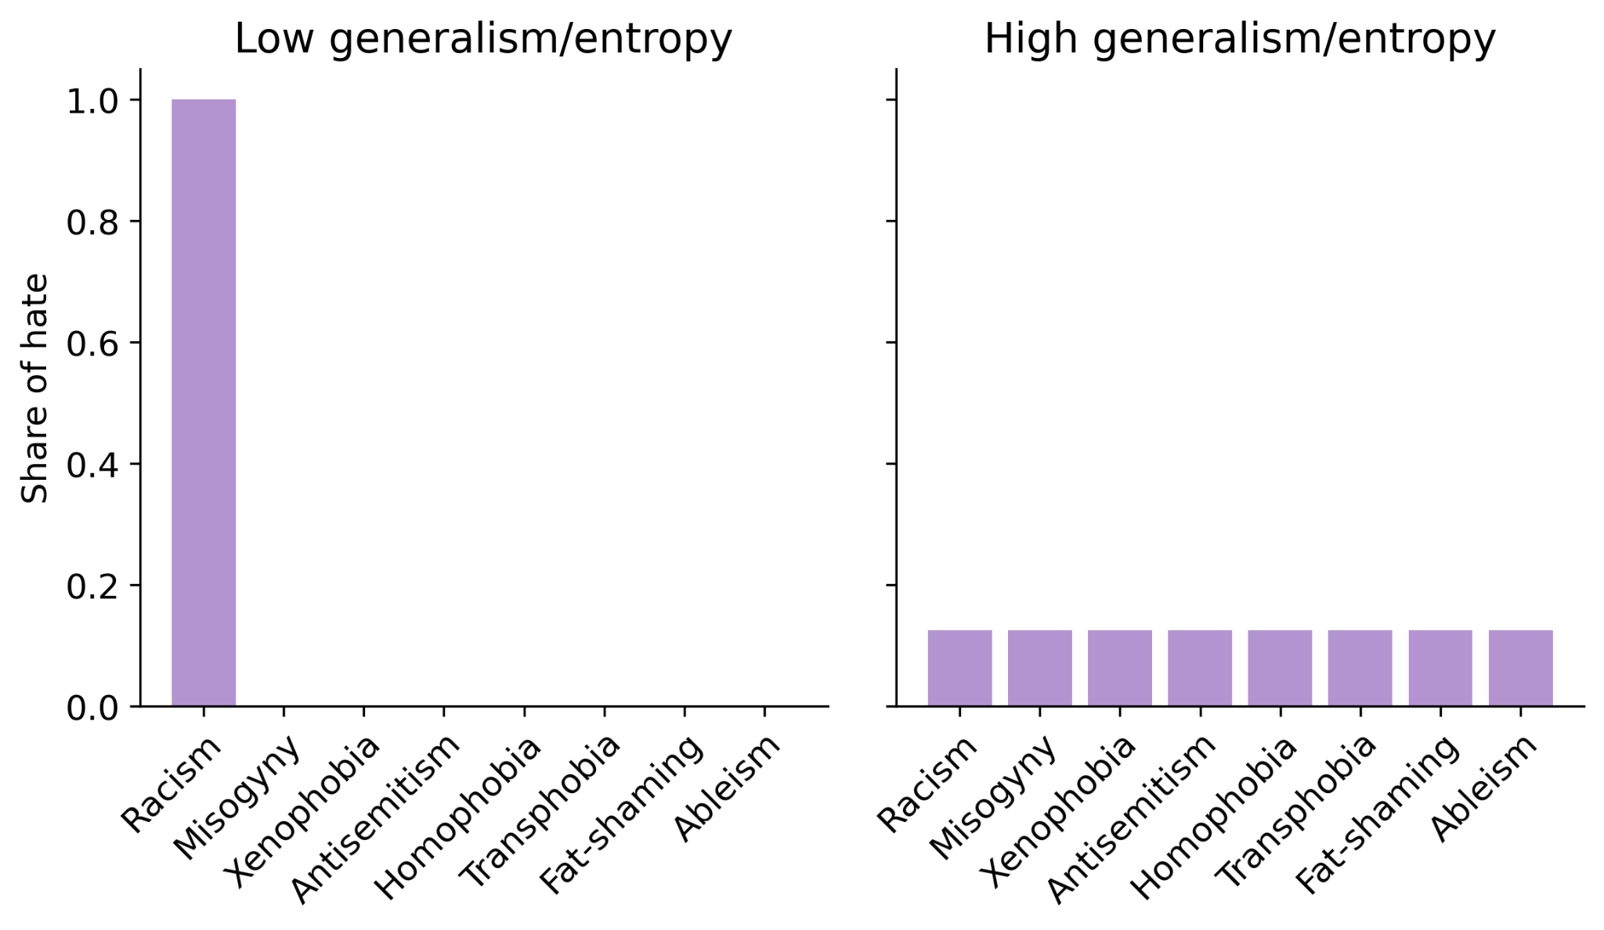
All-purpose Haters: Characterizing Hate Communities on Reddit
Daniel Hickey, Rafael Arellano, Daniel Faltesek
hickeyda@oregonstate.edu
Abstract:
While previous studies of hate subreddits have brought valuable insights, they focus on a narrow set of subreddits or ideologies
A more representative set of subreddits can help us understand whether previous results replicate
General trends in hate communities help contextualize results
More diverse typologies of hate help us understand the influence of cross-community interaction
How have hate subreddits changed over time?
Cross-subreddit contact: who is more likely to participate in r/Incels: A or B?
= active in r/Incels
In r/WhiteRights:
A
B
Hate speech levels of hate subreddits over time.
Result: cross-subreddit contact leads to subsequent engagement in hate subreddits
Temporal trends in hate subreddit size
UMAP plot representing clusters of hate subreddits
Method: collect potential hate subreddits from a variety of sources (prior research, r/AgainstHateSubreddits)
Query GPT-4 to detect hate of nine types from a sample of posts in each subreddit.
Using k-means, three clear clusters emerge – one highly misogynistic, one highly racist, one highly homophobic/transphobic
Network of subreddits
Node size = odds ratio
Subreddits with greater user overlap are closer to each other
Cross-subreddit contact is most effective for ban-evasion subreddits
Subreddits become more general in their hate throughout their lifespan
Measuring generalism: The entropy of a subreddit’s relative distribution of hate speech

